Slide 1

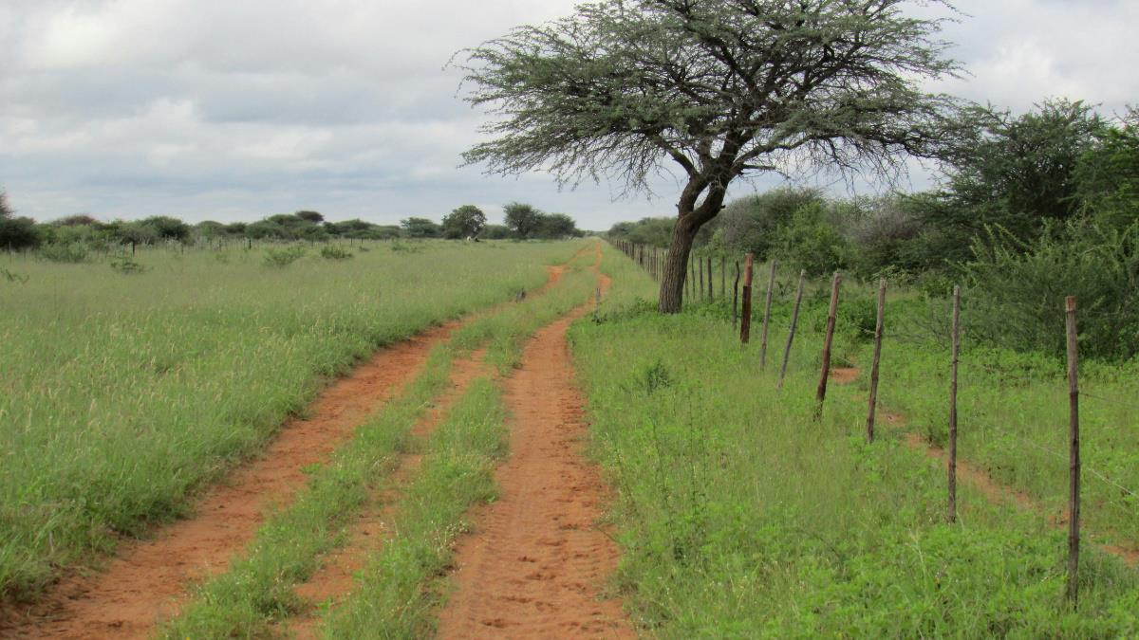
Presentation on AGRARIAN REFORM
FOR
THE 2ND NATIONAL LAND CONFERENCE , 1 – 5 OCTOBER 2018, WINDHOEK
By: P.W. MISIKA PERMANENT SECRETARY
REPUBLIC OF NAMIBIA
MINISTRY OF AGRICULTURE, WATER AND FORESTRY

Slide 2
PRESENTATION OUTLINE
1. State of Namibian Agriculture by 1991
2. Focus Issues
  2.1 Agrarian reform
  2.2 Veterinary Cordon Fence
  2.3 Support to farmers
3. Challenges
3.1 Agrarian reform
3.2 Veterinary Cordon Fence
3.3 Support to farmers
4.Recommendations
4.1 Agrarian reform
4.2 Veterinary Cordon Fence
4.3 Support to farmers

Slide 3
Focus Issues
Agrarian Reform
Veterinary Cordon Fence
Support to Farmers (including Pre and post resettlement farmers)

Slide 4
1. Namibian Agriculture by 1991
Agricultural sector in pre-independent Namibia
was administered in two tiers
  White, and
  Black tier administrations
The livestock sector was divided by the VCF into two parts
  Northern part, mainly comprising communal areas (animal disease endemic)
  Central and southern part comprising commercial and communal areas (animal disease free areas)
  Poultry, piggery and dairy industries were virtually insignificant

Slide 5
Agriculture in 1991 (Conti)
In the northern communal areas:
  Agricultural extension services were mainly focused on rain-fed
  crop and staple food production
  Crop production land under irrigation was merely 2,000 ha
  Livestock breeding and preservation of indigenous breeds took place at Livestock Development Centers
  (Alex Muranda, Mashare, Sachinga and Tsumkwe)
In the central and southern areas:
  Agricultural extension services were mainly towards livestock production
  Horticulture production was practiced at insignificant levels mainly in the maize triangle and Hardap scheme
  Namibia imported most of its horticultural requirement from South Africa
Access to potable in rural areas within a radius of 2.5 km was a meagre 43%

Slide 6
2. Focus Issues
2.1 Agrarian Reform
Government started consolidating agricultural activities in
the country at independence
Reforms initiated include:
- Development of Legal, institutional policy and strategic
frameworks
- Development of human resources
  Establishment and strengthening of institutional capacities for agricultural extension and research services throughout Namibia
  Coverage of agriculture research and extension services was extended to the entire country
  Improving Animal Health Status
  Increasing and improving Market Access

Slide 7
Agrarian Reform(Conti)
  2.1.2 Green Scheme Programme
Development of irrigation based agronomic production in Namibia
increase crop and horticulture production under irrigation
Land under irrigation increased from ± 2,000 ha at independence
to >11,000 ha
(5,600 ha under irrigation on State land)
Vision 2030 aims to put 27,000 ha of land under irrigation
Development of projects at Katima/Liselo, Zone,
Neckartal, Tandjeskoppe and Etunda Phases 7 and 8 will add
± 5,500 ha to a new total of 17,500 ha
Potentially ± 50,000 ha of undeveloped land in Namibia could be
irrigated

Slide 8
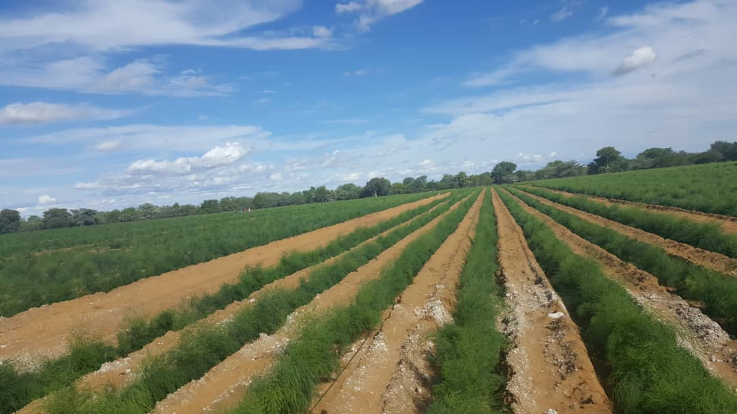
Agrarian Reform(conti)

Slide 9
Agrarian Reform(Conti)
  2.1.3 Fresh Produce Business Hubs
FPBHs constructed at Rundu and Ongwediva
Construction of the Windhoek FPBH is on hold due to
budgetary constraints
National annual demand for horticultural produce is about
± 74,000 tons
± 24,000 tons is produced locally and the difference of
± 50,000 tons is imported
FPBH aimed at reducing reliance on imports for fresh
produce

Slide 10
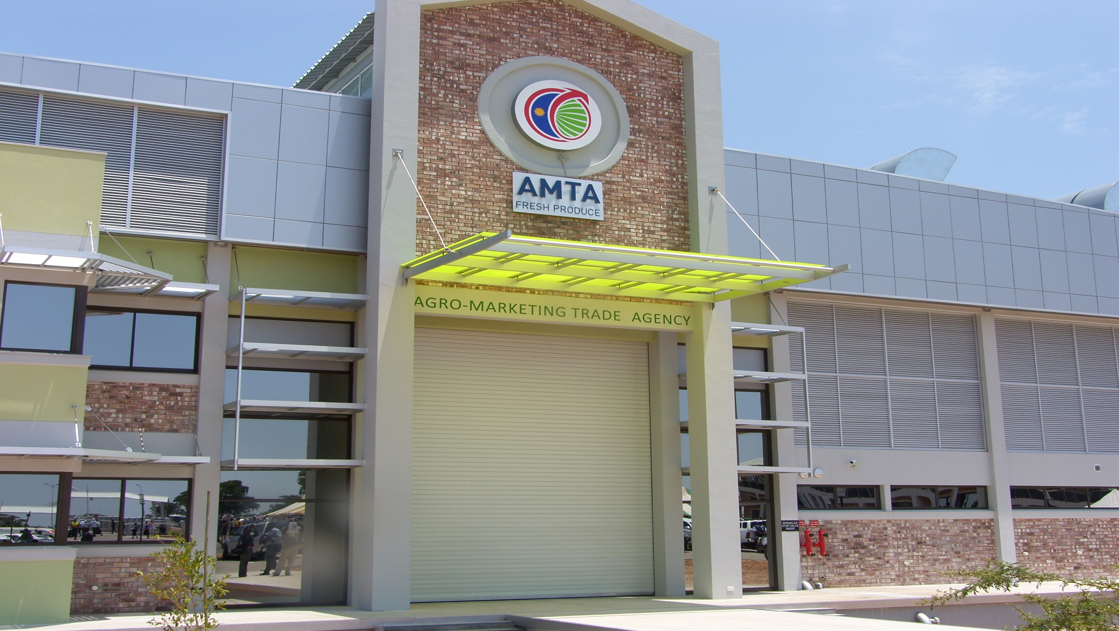
Agrarian Reform (conti)

Slide 11
Agrarian Reform(Conti)
2.1.4 National Strategic Food Reserves
To ensure national food security
At any given time, the country has enough food stock to feed its people whenever natural or man-made disasters strike
Benefits grain producers marketing
NSFR also used to stabilize market prices for grains in the event of sudden market price hikes
Exixsting NSFR capacity is 22,900 MT distributed across five grain producing regions of the country,
- Zambezi (7,400 MT), Kavango East (4,000 MT), Ohangwena (4,500 MT), Oshikoto (4,000 MT) and Omusati (3,000 MT)

Slide 12
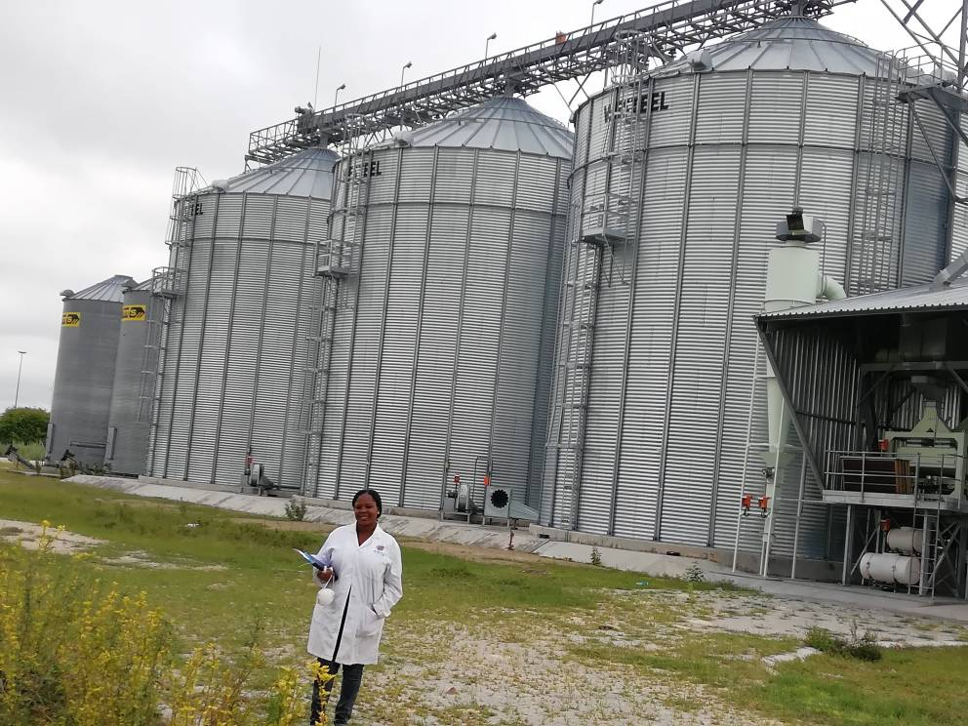
Agrarian Reform(Conti)
Adequate to sustain Namibia for a period of 3 months only
V2030 target is 67,000 MT by year 2030,sufficient to sustain the nation for a period of 12 months
Additional capacity of 44,100 MT need to be developed during the remaining <12 years.

Slide 13
Agrarian Reform(conti)
  2.1.5 Agriculture Technology Centers
Two (2) ATCs constructed at Ongwediva and Rundu
The ATCs operations include research and technology
adaptation, manufacturing, maintenance and repair of
agricultural machinery and
implements

Slide 14
Agrarian Reform(conti)
  2.1.6 Construction of Agricultural Development Centres
A total of 144 ADC constructed in all 14 regions
ADCs provide advisory services and training on technical and
management skills to farmers

Slide 15
Agrarian Reform(conti)
  2.1.7 Agricultural Research and Development
MAWF is engaged in the following research programmes and
projects:
  Crop Production Research
    Mutation breeding for Supa and Angola rice varieties improvement in Namibia
    Developed and released high yielding and drought resistant pearl millet, sorghum, Bambara groundnut and Cowpea through mutation breeding

Slide 16
Agrarian Reform(conti)
  Livestock Production Research
    Improvement of milk production of indigenous Sanga cattle at Sonop Research Station.
    Multiplication strategy of the Gellaper sheep
    Investigation on the lethal gene in white Swakara sheep (Karakul) at Gellap-Ost Research Station
    Evaluation of carcass characteristics of the Namibian indigenous goats

Slide 17
Agrarian Reform(conti)
  Rangeland and Pasture Research
    Fodder bank grazing system at Sandveld Research Station
    Browse Estimate by Canopy Volume (BECVOL) in Mopani Savannah
    Establishment of a cultivated pasture at Okapya Livestock Development Centre
    Forestry principles for sustainable wood harvesting, Northern Namibia.
    Gradual thinning of woody plants to achieve Savannah equilibrium.

Slide 18
Agrarian Reform(conti)
  2.1.8 Improvement of Animal Health
To improve marketing of livestock north of the VCF, MAWF undertook the following:
  Annual vaccination and tagging 88% of 1,6 million cattle against FMD and CBPP
  Constructed veterinary clinics at Outapi, Eenhana, Omuthiya, Okakarara and Epukiro
  Constructed 4,200 crushpens
  Constructed 54 Veterinary Rural Extension Centers
  Constructed border offices, houses and animal handling facilities at Ariamvlei, Noordoewer, Buitepos, Oshikango, Mahenene, Kasamane, Katwitwi, Wenela, Swaartbooidrift, Oronditi and Dobe.

Slide 19
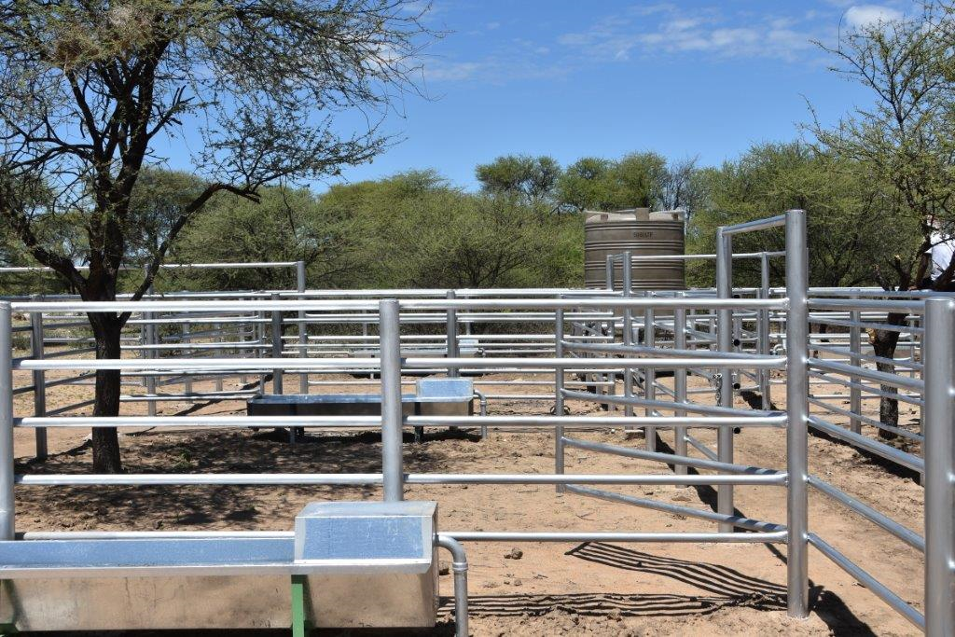
Agrarian Reform(conti)

Slide 20
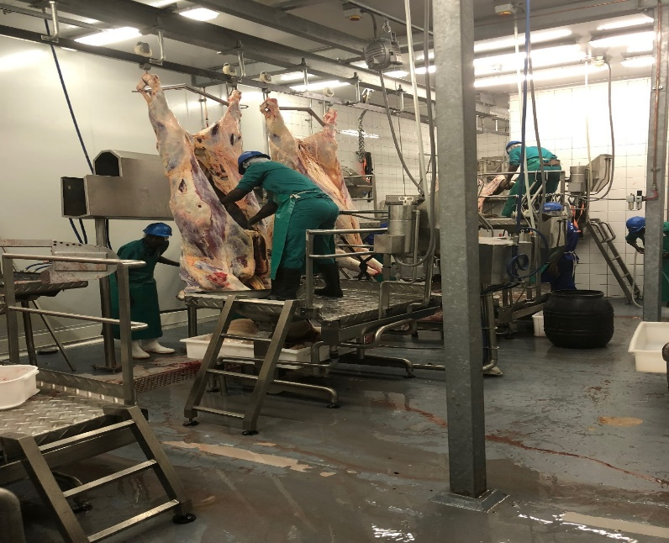
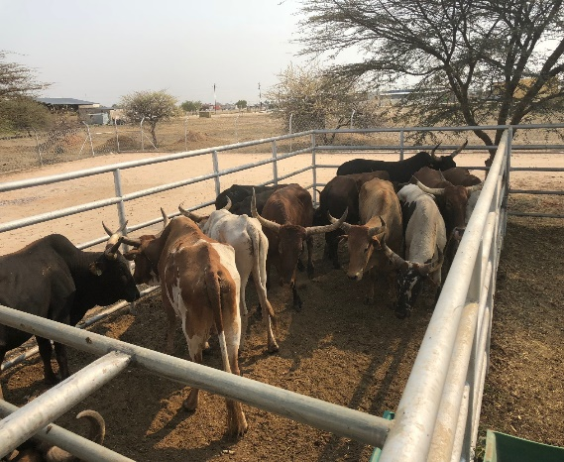
Agrarian Reform(conti)
2.1.9 Enhancing Market Access for NCA Livestock
MAWF established quarantine facilities in:
- Zambezi(Kopano and Sachinga),
- Kavango East(Matumbo Libebe)
- Oshikoto(Oshivelo and Okapya)
- Ohangwena(Okongo)
- Omusati(Omutambo Omahwe)
  Upgraded and is constructing abattoirs at Outapi, Eenhana, Rundu and Ongwediva meat processing plant
  Planning to upgrade the Opuwo abattoir and constructing meat processing plant at Bukalo
  Trained over 60 Namibian veterinarians
  Supported the establishment of the Namibian Veterinary School at UNAM

Slide 21
2.2 Veterinary Cordon Fence(VCF)
NCA FMD and CBPP status remains unchanged
So far, three schools of thought to address this:
  Removal of the Veterinary Cordon Fence (VCF)
  Translocation of VCF to northern border with Angola
  Creation of Food and Mouth Disease (FMD) and CBPP (known as lung sickness) free zones within a 30km km zone on both the Namibian and Angolan side, in line with the World Organization for Animal Health (OIE) standards
Pros and Cons of options
  Namibia’s FMD Free zone will lose its disease free status, if VCF is removed immediately
  Will lead to loss of market access to regional and international lucrative markets
  Trans-locating the VCF to borders with Angola is the most plausible
  It is costly and will take time to secure the adequate financial resources for the construction of border VCF
  There is a need to establish the exact coordinates of the borderline which would require representatives from Namibia, Angola and observers from SADC and AU
  Require buy-in, cooperation and collaboration of all stakeholders
  Astronomic costs including regular disease surveillance, border patrols, fence maintenance, personnel to man the border gates and the erection of quarantine facilities
  Area was a war zone, hence need for demining before the construction of VCF may delay the process.
  Third option requires vaccination against FMD and CBPP in Namibia’s Protection zone and 30 km into Angola for a stretch of ± 600 km, intensive surveillance, animal identification and traceability on both sides, ability to detect disease rapidly, ability to respond to disease outbreaks effectively, ability to prevent disease incursion, demonstration of the absence of the disease through surveillance
  Vaccinating animals in the Protection zone and 30km into Angola for a stretch of ± 600 km is too costly for Namibia and unsustainable

Slide 22
2.3 Support to Farmers
  2.3.1 Cooperative Loan Guarantee Fund
MAWF established CLGF to facilitate access to credit for
cooperatives, through loan guarantees
Administered through the Agribank
2.3.2 Small Stock Distribution and Development Project
SSDDP implemented in communal areas of all 14 regions
Provides quality core breeding flock of suitable local
goats to selected vulnerable households
Targets 20 selected small scale communal rural
households
Since inception, 60 farmers benefited through allocation
of 1260 goats

Slide 23
Support to Farmers(conti)
  2.3.3 Affirmative Action Loan Scheme
Aided previously disadvantaged communities access to
commercial agricultural farmland
AALS complemented by the North-South Incentive Scheme
(NSIS)
NSIS facilitated movement of AALS beneficiary communal
farmers north of VCF to commercial farms south of VCF
NSIS also aimed at assisting animal off-take of the
rangelands in areas north of VCF
Through AALS, 1008 farmers resettled on 5,968,644 ha.

Slide 24
Support to Farmers (Conti)
  2.3.4 Dry Land Crop Production Programme
DCPP implemented in all the crop growing regions of the country, namely Zambezi, Kavango West, Kavango East, Omusati, Ohangwena, Oshikoto, Kunene, Otjozondjupa and Omaheke
Provision of subsidized fertilizer, improved seeds, ploughing
and weeding services to communal farmers
  2.3.5 Conservation Agriculture Programme
To reduce and reverse land degradation
Mitigate the impact of climate change through the adoption
of Conservation Agriculture (CA) practices
Basis for sustainable crop production and improved food
security at national and household level
CA implemented with support of cooperating partners in all
crop producing regions

Slide 25
Support to Farmers(Conti)
2.3.6 Namibia Agricultural Mechanization and Seed Improvement
Project
NAMSIP, a 5 year project is funded through African Development Bank Loan
To improve household food security, nutrition, job creation, household income and livelihoods of rural people
Aims to increase agricultural production and productivity
Supports agricultural production through mechanization and certified seed systems
Agricultural scheme will be implemented in 14 regions of Namibia
Seed systems development scheme will be implemented in Kavango East, Kavango West, Oshana, Omusati, Oshikoto and Zambezi region.

Slide 26
Agrarian Reform(conti)
  2.3.7 Climate Resilient Agriculture in three of the Vulnerable Extreme northern crop-growing regions
CRAVE implemented in Zambezi, Kavango East and Kavango
West
Funded through a grant by the Environmental Investment
Fund (EIF)
Complementing the Comprehensive Conservation
Agriculture Programme
Capacitates beneficiaries to acquire skills and knowledge to
adopt conservation agriculture and climate-resilient
agricultural practices

Slide 27
Support to Farmers(conti)
  2.3.8 Nurseries
Seedling nurseries established to produce seedlings for shade and fruit trees
Seedlings sold at subsidized prices as well as donated to the public
Seedlings planted in GRN orchards and woodlots for demonstration and research trials
  2.3.9 Orchards
Several orchards established to produce fruits to contribute to national food security
Orchard increase the vegetation cover
Some orchards used for research trials to investigate adaptability of the trees to the environment
Management of the orchards to be handed over to communities and other relevant institutions for their sustainable management

Slide 28
Support to Farmers (Conti)
2.3.10 Rural Water Supply
Access to potable water in rural areas improved from 43% to the current 85% within a radius of 2.5 km

Slide 29
Support to Farmers(Conti)
  2.3.11 Pre and Post Settlement Support Services
MAWF developed and implemented the Capacity Building
Strategy for Resettlement Farmers 2017-2022 to improve
the capacities of resettled farmers to increase
yields and market orientated production
Specific Desired Outcomes:
  Established system for programmes and projects planning in support of resettlement farms;
  Strengthened Capacities of resettled farmers in technical and managerial skills for achieving sustainable and commercially viable production;
  Strengthened capacities of training and advisory services of various stakeholders to support resettlement program.

Slide 30
3. Challenges to Agrarian Reform
  3.1 Commercial Agricultural Sub-Sector
  High Production Costs of Imported agriculture production inputs
  Bush encroachment- High costs of bush thinning, diverting much needed resources from actual production
  Reliance on rainfed agriculture
  Climate change- droughts, prolonged dry spells and floods
  Land and soil degradation
  Poor rangeland management practices,
  Lack of markets for agricultural produce’

Slide 31
Challenges to Agrarian Reform (conti)
    3.1.1 International Market Concentration
Reliance on traditional agricultural export markets
This, despite market access opportunities created by Government through Free Trade Agreements
Emerging threat to sustainable long term existence of the livestock subsector
  Eexodus-style exportation of livestock on hoof
    3.1.2 Decreasing Productivity of Livestock Farmland
Overgrazing
  overstocking on smaller portions of subdivided agricultural farm units
  Bush encroachment
  Poor rangeland management
    3.1.3 Change of Agricultural Land Use
Conversion of livestock and crop farms into game farms, lodges and real estates
  - Country’s population and demand for food is increasing

Slide 32
Challenges to Agrarian Reform (Conti)
    3.1.4 Access to Existing Formal Distribution Chain Market
Domestic formal market dominated by distribution chains/cartels linked to producers in countries of origin
Where retailers/distributors are compelled to source regulatory quotas locally, they tend to source exclusively from the well-established local commercial farmers, effectively excluding of small scale or previously disadvantaged farmers
Domestic market largely made up of previously disadvantaged communities
    3.1.5 Dilapidating Farm Infrastructure
Successful commercial farming partially depends on good infrastructure on the farm
  Including water, fencing, machinery and implements
  Some resettlement farms have aged or dilapidated infrastructure

Slide 33
3.2 Challenges of Support to Farmers(conti)
    3.2.1 Uneconomically Viable Farming Units
Most resettled farmers settled on uneconomically viable farming units due to
  Poor quality of the land
  Small land sizes
  Dilapidated or non-existent infrastructure
    3.2.2 Pre and Post Resettlement Farmer Support
Inadequate training and poor access to production finance for Resettlement Programme beneficiary farmers
Hence, many beneficiaries not farming successfully

Slide 34
Challenges (conti)
    3.2.3 Inflated Farm Prices
Prices for commercial farmland have been increasing since independence
  Current market prices are no longer equivalent to actual value of the commercial farms
  Unprecedented pressure on new AALS farm owners to settle land acquisition loans, leading high default rates
    3.2.4 Practice of Subdividing Agricultural Land to Service Land Acquisition Debt
Highly inflated farm prices
Led to increased number of applications to subdivide agricultural land
  With a view to settle land acquisition loans
  Subdivided uneconomically viable farm portions create financial pressure to new farm owners
    3.2.5 Access to Finance for Production Inputs
Lack of collateral by communal farmers impedes their access to production loans
Non-collateral loans products by Agribank assists with permanently employment

Slide 35
4. MAWF Recommendations (Conti)
  4.1 On Agrarian Reform
  4.1.1 High agricultural production costs
  Government should actively support initiatives aimed at fodder production in the country
  20%-30% of land under Green Scheme irrigation should be reserved for fodder production
  Support communal farmers to produce fodder both under irrigation and rain-fed conditions
  Implement the HPP strategy for establishing a fertilizer mixing plant should be prioritized through PPP
  Encourage farmers to venture into commercial bush utilization and value addition operations
  Encourage stakeholders to establish feedlots
  4.1.2 Research and Development
  Strengthen research and development collaboration and cooperation with tertiary institutions, private sector and development partners to improve agricultural production and productivity, value addition and markets access
  4.1.3 International Market Concentration
  Encourage exporters of Namibian agricultural produce and Processed Agricultural Products (PAPs) to develop and diversify markets for their agricultural produce and PAPs in all markets secured by Government
  Tighten regulations aimed at curbing exodus-style exportation of livestock on hoof, in order secure sufficient throughput at local abattoirs and meat processing facilities
  Strengthen border inspection and control to prevent smuggling of Namibia’s livestock resources
  4.1.4 Decreasing Productivity of Livestock Farmland
  Farmers should be encouraged to stick to the carrying capacities of their farmlands
  Prohibition of subdivision of agricultural land into uneconomically viable units should be fully enforced

Slide 36
MAWF Recommendations (Conti)
  4.1.5 Change of agricultural land use
  At least 80% of total agricultural land in Namibia should at all times be reserved for livestock and crop production purposes and that it should never be reduced
  4.1.6 Marketing of Namibian agricultural produce and PAPs
  Tighten border inspection and control to ensure effective implementation of regulatory marketing schemes, such and Market Share Promotion (MSP) for horticulture, Close and Open Border Periods for controlled grains produce, etc.
  Devise new market regulations to support the growth at home of the meat, leather, dairy, poultry industries

Slide 37
MAWF Recommendations
  4.2 On VCF
  Focus on alternatives that will nullify the adverse effects of the VCF at its current position
    To facilitate market access for ± 1.6 million cattle, 680 752 goats, and 432 800 sheep from the NCA
  Devise solutions that will improve the animal health status, quality of NCA livestock and ensure that Namibia has a single and fully integrated livestock industry
  Adopt and implement the commodity based trade as approved by the OIE
    Construct and complete the upgrading the abattoirs at Rundu, Eenhana, Opuwo
    Construct and complete of meat processing facilities Bukalo and Ongwediva
    Operationalize Oshakati and Katima Mulilo abattoirs

Slide 38
MAWF Recommendations (Conti)
  Rehabilitate existing quarantine facilities for efficient disease control
  Adopt compartmentalization disease free status approach by establishing and implement disease free livestock compartments in the NCA, to include some parts of Kunene north (Sesfontein area), Oshana (Ombuga area), Omusati (Omutambo Mawoe area), Kavango-west (Karikubis and Mangetti-east farms) and Oshikoto (Mangetti-west and Onalusheshete farms)
    This would result into gradual inclusion of semi-commercial farms and other FMD and CBPP low-risk areas in the NCA into the FMD free zone
  Allow movement of cattle not vaccinated against FMD that have undergone 90 days quarantine from the NCA to south of VCF for direct slaughter at export approved abattoirs
  Construction of the VCF along the Namibia/Angola border is the most plausible long term solution for achieving FMD and CBPP freedom recognized by OIE
NOTE: It is important to note that the existing VCF should not be removed, as it can be used to control disease outbreaks

Slide 39
MAWF Recommendations (Conti)
4.3 On Support to Farmers
4.3.1 Uneconomical Viable Farming Units
  MLR should always consult MAWF on the subdivision of acquired resettlement farms to ensure that sizes of resettlement farm portions are economically viable
  MLR should prioritize the development of farming infrastructure on the resettlement farm portions, prior to resettlement
4.3.2 Pre and Post Resettlement Farmer Support
  The function of training resettled farm beneficiaries should be transferred from MLR to MAWF to ensure effective imparting of farming knowledge and skills to beneficiaries
  Resettlement farm beneficiaries should be provided with subsidized production machinery and implements
  Resettlement farmers should be encouraged to form cooperatives in order to access production loans through the Cooperative Loan Guarantee Fund
4.3.3 Access to finance by communal farmers
  Communal farmers should be encouraged to form cooperatives in order to access production loans through the Cooperative Loan Guarantee Fund

Slide 40
MAWF Recommendations (Conti)
  4.3.4 Pre-and Post-Settlement farmer Support
  Make adequate budgetary provision for the implementation of the pre and post settlement farmer support strategy
4.3.5 Implement the HACCIADEP commodity value chain
development schemes
4.3.6 Use government purchasing power as a market facilitation for
agricultural produce to stimulate sustainable agriculture production

Slide 41
FAO Quote
‘’The eradication of hunger and poverty , and the sustainable use of the environment, depend in large measure on how people, communities and others gain access to land, fisheries and forests. The livelihood of many, particularly the rural poor, are based on secure and equitable access to and control over these resources. They are the source of food and shelter; the basis for social, cultural and religious practices; and a central factor in economic growth’’

Slide 42
I THANK YOU

